Slide 1
Discussion 1
Control & Environments
Jason Zhou | Section 136
CS61A Fall 2018

Slide 2
Announcements
Office Hours:
Wednesdays 5:00 - 6:00 PM
109 Morgan Hall
+1 more OH per week starting next week
Lab 0, 1 due today
Project 1: Hog
Phase 1: Tuesday 2/05
Phase 2, 3: Thursday 2/07
*Phase 1, 2, 3: Wednesday 2/06
+1 Extra Credit
Half-way+ to midterm 1
Monday 2/11

Slide 3
Agenda
Expr., Names, Ctrl Review
Quick Control Practice
Environment Diagrams Review
Environment Diagrams Practice

Slide 4
Operators
Arithmetic Operators: +, -, *, /, //, %, **
Comparison Operators: >, <, >=, <=, ==, !=
Assignment Operators: =, +=, -=, /=, **=, //=
Boolean Operators: and, or, not
Functions

Slide 5
Expressions
An expression describes a computation and evaluates to a value
e.g. add(3, 4)
Evaluation Anatomy:
evaluate operator, then evaluate operand(s)
apply operator to operand(s)

Slide 6
Truthy & Falsy Values
falsy:
0, None, False, “”, (and more to come)
truthy:
not a falsy value

Slide 7
Boolean Operators: Short-circuiting
and:
returns first falsey value or last truthy value
stops evaluation after first falsy value
Example: 0 and 1/0
or:
returns first truthy value or last falsey value
Stops evaluation after first truthy value
Example: 0 or 1 or 1/0

Slide 8
Functions
Syntax:
def <name>(<formal parameters>):
return <return expression>
Example:
def add(a, b):
return a + b

Slide 9
Functions
Call expressions:
<name>(<formal parameters>)
Example:
add(3, 4)

Slide 10
Control Review
If, else if, else statements:
if <conditional expression>:
<suite of statements>
elif <conditional expression>:
<suite of statements>
else:
<suite of statements>
While loops:
while <conditional expression>:
<suite of statements>

Slide 11
Control Problems

Slide 12
Lambda Functions

Slide 13
Lambda Functions
<name> = lambda <formal parameters> : <return expression>
x = lambda a, b : a + b
>>> x(2, 3)
5
Compare to:
def x(a, b):
return a+b

Slide 14
Lambda Functions
def foo(a, b):
def bar(c, d):
return a*b + c*d
return bar
foobar = lambda a, b: lambda c, d: a*b + c*d

Slide 15
Environment Diagrams

Slide 16
Environment Diagrams
Analyze and track code interpretation and execution
Able to break down complex code step-by-step
Always make up a non-trivial chunk of points on midterm 1
Rigorously, carefully, neatly follow a set of rules to solve these problems
Not a test of your puzzle solving/thinking/inquiry skills
We can only make the questions hard by making the code complex
The rules don’t change
Aim to be getting almost all points on env. diagram problems

Slide 17
Environment Diagrams
Step 1: Create a global frame
Step 2: For each type of relevant code statement, follow the respective rules
Assignment Statements
Ex: x = 1
b. def Statements
Ex: def foo(a, b, c):
return (a%b)**c
c. Call Expressions
Ex: foo(52, 1, 20)

Slide 18
Environment Diagrams
Assignment Statements
Evaluate all expressions to the right of = from left to right
Evaluating variable => “look-up”* a variable
Bind all names to the left of = to those resulting values in the current frame
e.g. x = 5
y = x

Slide 19
Environment Diagrams
def Statements
Create a new function object with given signature
func <name>(<formal parameters>) <parent=parent frame>
func add(a, b) <parent = Global>
func add(a, b) <p = Global>
Parent frame is the frame the function is created in
Bind function name to function object with pointer
*Function body is not evaluated until the function is called
e.g. def add(a, b):
return a + b

Slide 20
Environment Diagrams
Call Expressions
Add a new local frame, forming a new environment
F<index>: <intrinsic name> <Parent = <parent frame name>>
Bind the function's formal parameters to its arguments in that frame
Execute the body of the function in that new environment
No return value => return None
e.g. add(4, 5)

Slide 21
Environment Diagrams
Misc.
Cannot have two variable with the same name
When looking for a variable, the look-up order is:
Current Frame
Parent Frame
Parent Frame’s Parent Frame
…
Global Frame
If still not found, error

Slide 22
Env. Diagram Problems

Slide 23
Environment Diagrams
http://pythontutor.com/visualize.html#mode=edit
Example: https://goo.gl/2fxibk

Slide 24
Exam Prep:
Env. Diagram Problems

Slide 25
Environment Diagrams
def a():
def g():
return 3
return k(g)
def k(b):
return b()
z = a()

Slide 26
Environment Diagrams
Global
a |
func a() [parent=Global]
func k(b) [parent=Global]
k |
z | 3
f1: a [parent = Global]
g |
func g() [parent=f1]
Return value | 3
f2: k [parent = Global]
b |
Return value | 3
f3: g [parent = f1]
Return value | 3

Slide 27
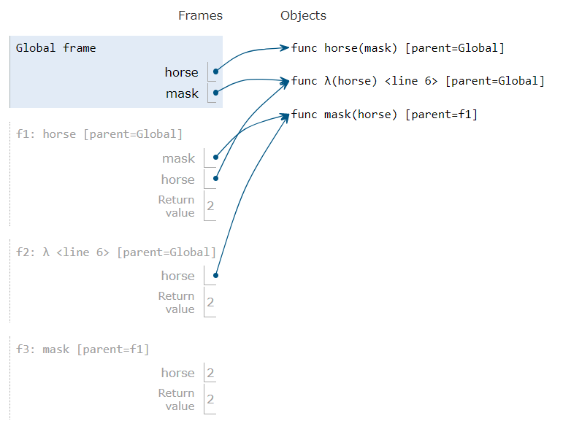
Environment Diagrams
def horse(mask):
horse = mask
def mask(horse):
return horse
return horse(mask)
mask = lambda horse: horse(2)
horse(mask)

Slide 28
Attendance
Slides
links.cs61a.org/jasonz-attendance
jasonxzhou.com/teaching

